Slide 1


K RAMAKRISHNAN COLLEGE OF TECHNOLOGY
(Autonomous)
TEXT DETECTION AND EXTRACTION WITH TEXT TRANSLATION AND TEXT-TO-SPEECH USING DEEP LEARNING TECHNIQUES
Guided By:
PRESENTED BY,
Mrs. GEETHA.S ., M.E,AP/AI
AATHIRAJU.M – 811721243001
GOWRI SHANKAR.S – 811721243017
KIRUSHIGAN.R – 811721243025
RAJADURAI.M - 811721243303

Slide 2
OBJECTIVE
This project focuses on developing a text extraction application using Deep Learning. It leverages the EasyOCR library to accurately extract English and Tamil text from images. Users can translate the extracted text into different languages, enabling seamless text retrieval from various sources.
2

Slide 3
EXISTING SYSTEM
Uses OpenCV and Tesseract OCR for text extraction.
Supports only English by default; extensions require extra models.
No real-time camera scanning.
Requires manual setup of OpenCV, Tesseract, and dependencies.
Language models need separate installation.
3

Slide 4
PROPOSED SYSTEM
EasyOCR Library:
An open-source tool for extracting multi-lingual text from images, simplifying OCR implementation.
Creates shadow of the text to detect the characters.
Real-time Scanning:
Supports live text detection using webcams or mobile cameras for instant recognition.
Translation:
Allows translation of extracted text into multiple languages, enhancing accessibility.
4

Slide 5
LITERATURE SURVEY
S. No. | Paper Title | Author Name | Year Of Publish | Techniques Used | Merits | Demerits
1 | Extraction Algorithm of English Text Information From Color Images Based on Radial Wavelet Transform | YAQIN WANG | Aug, 2020 | Pseudo-boundary phenomena. Text characteristic by color signals. | Noise Reduction Text Localization Scalability | Complexity Limited Language Support Sensitivity to Distorted Text
2 | Efficient Text Bounding Box Identification Using Mask R-CNN: Case of Thai Documents | PHANTHAKAN , DITTAYA WANVARIE & NAGUL HAROJANANONE | Mar,2024 | OCR Module R- CNN | Robust to Variations Adaptability | Slower Processing Complex Architecture High Cost
5

Slide 6
LITERATURE SURVEY
S. No. | Paper Title | Author Name | Year Of Publish | Techniques Used | Merits | Demerits
3 | Cursive Text Recognition in Natural Scene Images Using Deep Convolutional Recurrent Neural Network | MARK R, MD.ASIKUZZAMAN, ASGHAR ALI & MEHWISH LEGHARI | Jan,2022 | CNN RNN OCR Module | Robust to Variations Unconstrained Environment | Limited Performance Longer Training Sensitive to Blurred Text
4 | CameraKeyboard: A Novel Interaction Technique for Text Entry Through Smartphone Cameras | ALESSIO BELLINO & VALERIA HERSKOVIC | Dec,2020 | OCR Module CNN Open CV | Robust to Variations Faster Input Adaptability | Higher Processing Requirements Recognition Errors
5 | SMART TEXT SCANNER: AN ENHANCED CAMERA-BASED INPUT METHOD FOR MULTILINGUAL TEXT EXTRACTION AND CONVERSION | PRIYA NATARAJAN, RAHUL MEHTA | Aug,2023 | easyOCR gTTS | Supports multilingual translation real-time use | OCR depends on image clarity Limited offline support
6

Slide 7
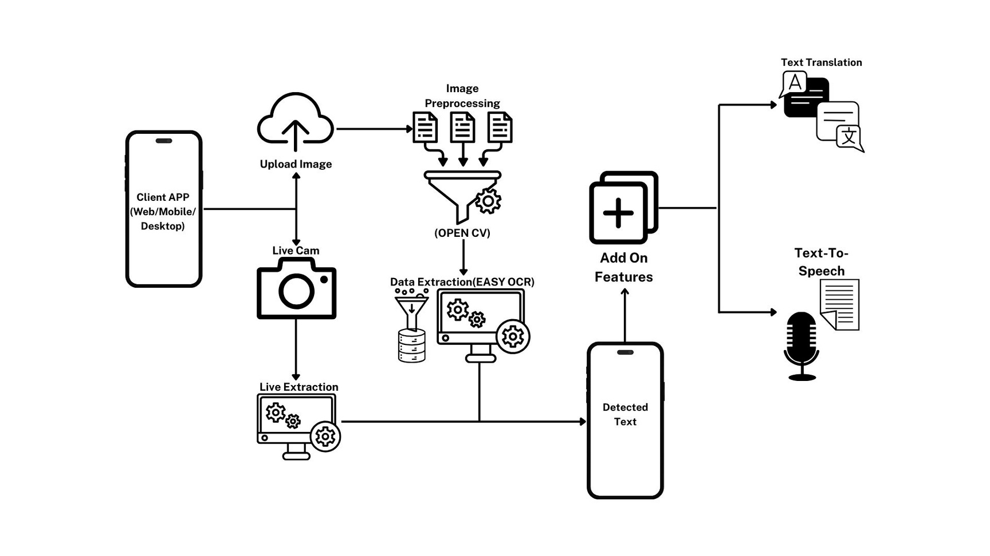
SYSTEM ARCHITECTURE
7

Slide 8
SYSTEM SPECIFICATION
Software Requirements
Hardware Requirements
Programming Language: Python 3.7 or later
Libraries:
Deep Learning: TensorFlow or PyTorch
NLTK
EASYOCR
gTTS
Googletrans
Environment: VS Code or Pycharm
Database: PostgreSQL or MongoDB
Version Control: Git
Operating System: Linux or Windows
GPU: NVIDIA RTX 3050 series or higher with 8GB VRAM or more
CPU: Intel i7/i9 or AMD Ryzen 7 or more with atleast 8 cores
RAM: 16GB or more
Storage: 1TB SSD
8

Slide 9
MODULES
User Interface
Data Preprocessing Module
Text Detection and Extraction Module
Translation Module
Text-to-Speech Synthesis Module
Post-Processing Module
9

Slide 10
USER INTERFACE
Purpose - The purpose of a User Interface (UI) is to provide an intuitive and interactive platform for users to efficiently interact with software or systems.
Features
Intuitive Design - Ensures easy navigation for users.
Responsive Layout - Adapts to different screen sizes.
Accessibility Features - Supports users with disabilities.
Interactive Elements - Enhances user engagement and interaction
The purpose of the User Interface (UI) is to provide an intuitive, interactive platform for users to interact with software or systems, enhancing usability, accessibility, and overall user experience.
10

Slide 11
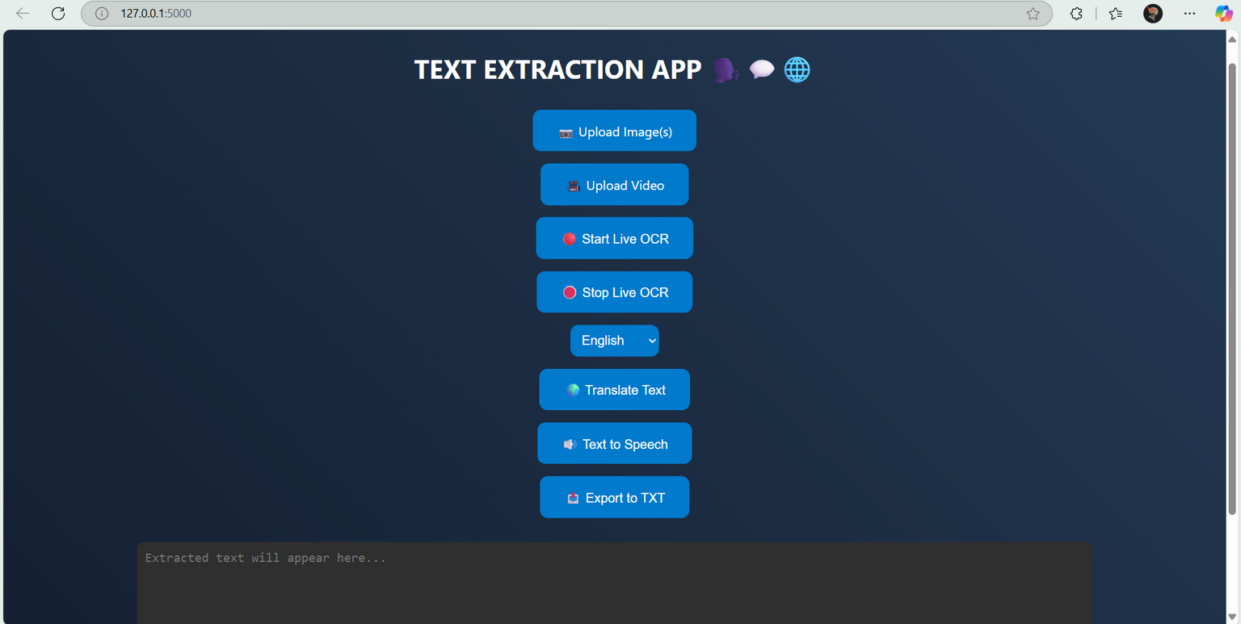
USER INTERFACE
SCREENSHOT
11

Slide 12
DATA PREPROCESSING MODULE
Purpose - The purpose of the Data Preprocessing Module is to clean, transform, and prepare raw data for analysis or machine learning models.
Features
Data Cleaning - Removes inconsistencies, duplicates, and errors.
Feature Selection - Identifies and selects relevant features for analysis.
Data Transformation - Normalizes, scales, and encodes data for modeling.
Missing Value Handling - Imputes or removes missing data points.
The Data Preprocessing Module is responsible for cleaning, transforming, and organizing raw data into a structured format suitable for analysis or modeling.
12

Slide 13
TEXT DETECTION AND EXTRACTION MODULE
Purpose - To detect text from the uploaded image or live image using EasyOCR
Features
Accurate Text Recognition: Extracts text from images, scanned documents, and PDFs with precision.
Multilingual Support: Detects and extracts text in multiple languages.
Flexible Input Handling: Supports various formats like JPG, PNG, and PDF.
Post-Processing Capabilities: Enhances extracted text with spell correction and formatting.
A Text Detection and Extraction Module identifies and extracts text from images or scanned documents using techniques like OCR, enabling data retrieval for analysis, processing, or storage efficiently.
13

Slide 14
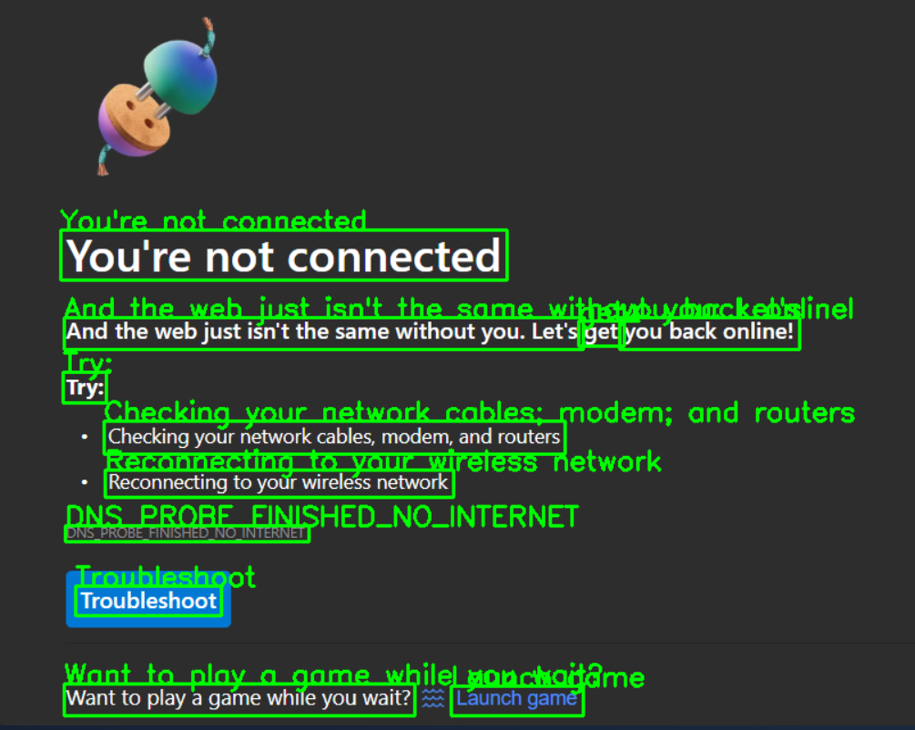
TEXT DETECTION AND EXTRACTION MODULE
WORKING
Green text above - Shadow characters
- Bounding Box
14

Slide 15
TRANSLATION MODULE
Purpose - Facilitates the conversion of text from one language to another for improved communication and understanding.
Features
Language Support: Translates text, speech, and documents across multiple languages.
Context Awareness: Ensures accurate translations by understanding context.
Real-time Translation: Provides instant translation for live interactions.
A translation module is a software component or system responsible for converting text or speech from one language to another, ensuring accurate and contextually appropriate language transformation for communication.
15

Slide 16
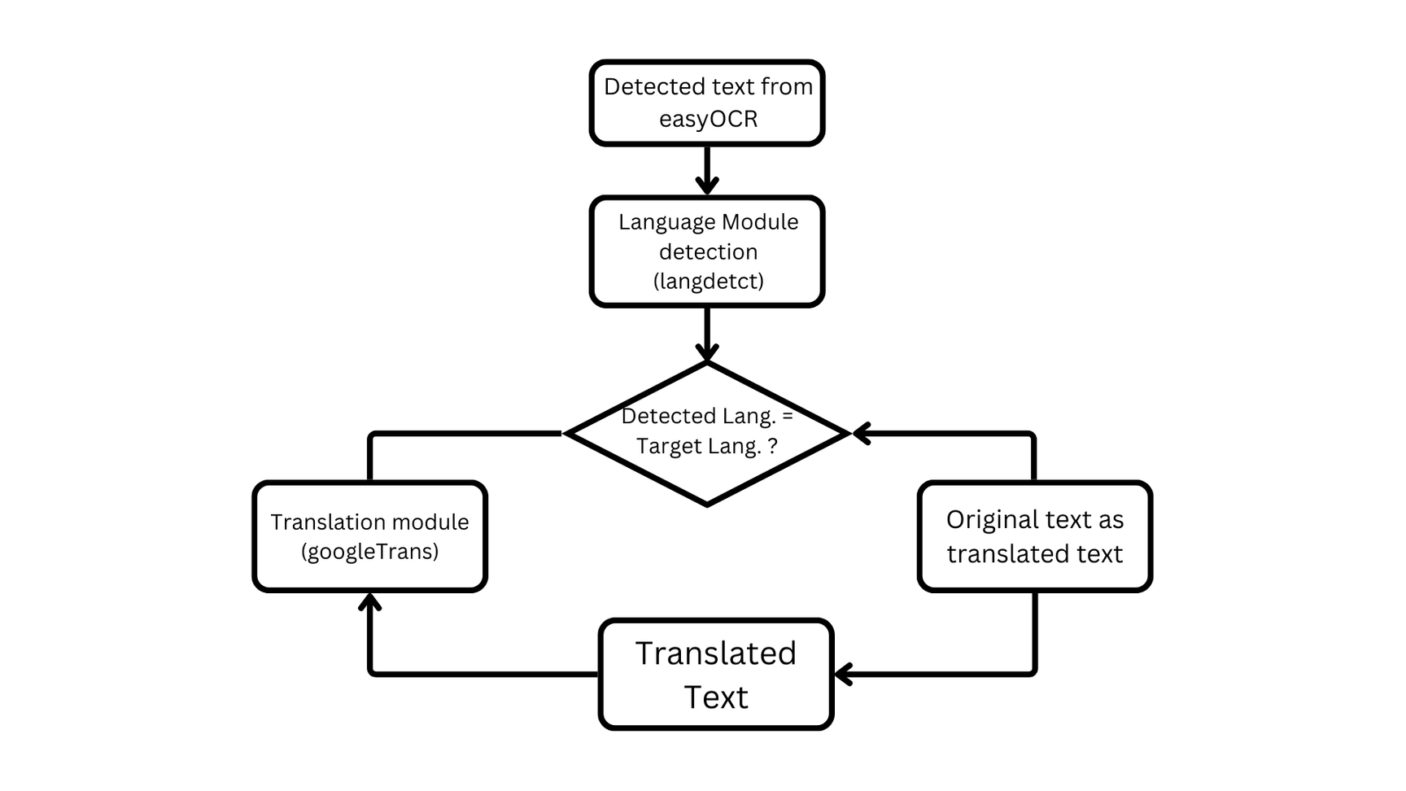
TRANSLATION MODULE
WORKING
16

Slide 17
TEXT-TO-SPEECH SYNTHESIS MODULE
Purpose - The purpose of the Text-to-Speech Synthesis Module is to convert written text into natural-sounding spoken language.
Features
Natural-sounding Voice Generation: Converts text into human-like speech with natural intonation and rhythm.
Multiple Language Support: Offers voice synthesis in various languages and dialects for global accessibility.
Real-time Processing: Provides immediate text-to-speech conversion for interactive applications.
A Text-to-Speech (TTS) Synthesis Module is a system that converts written text into spoken voice output using artificial intelligence and speech processing technologies.
17

Slide 18
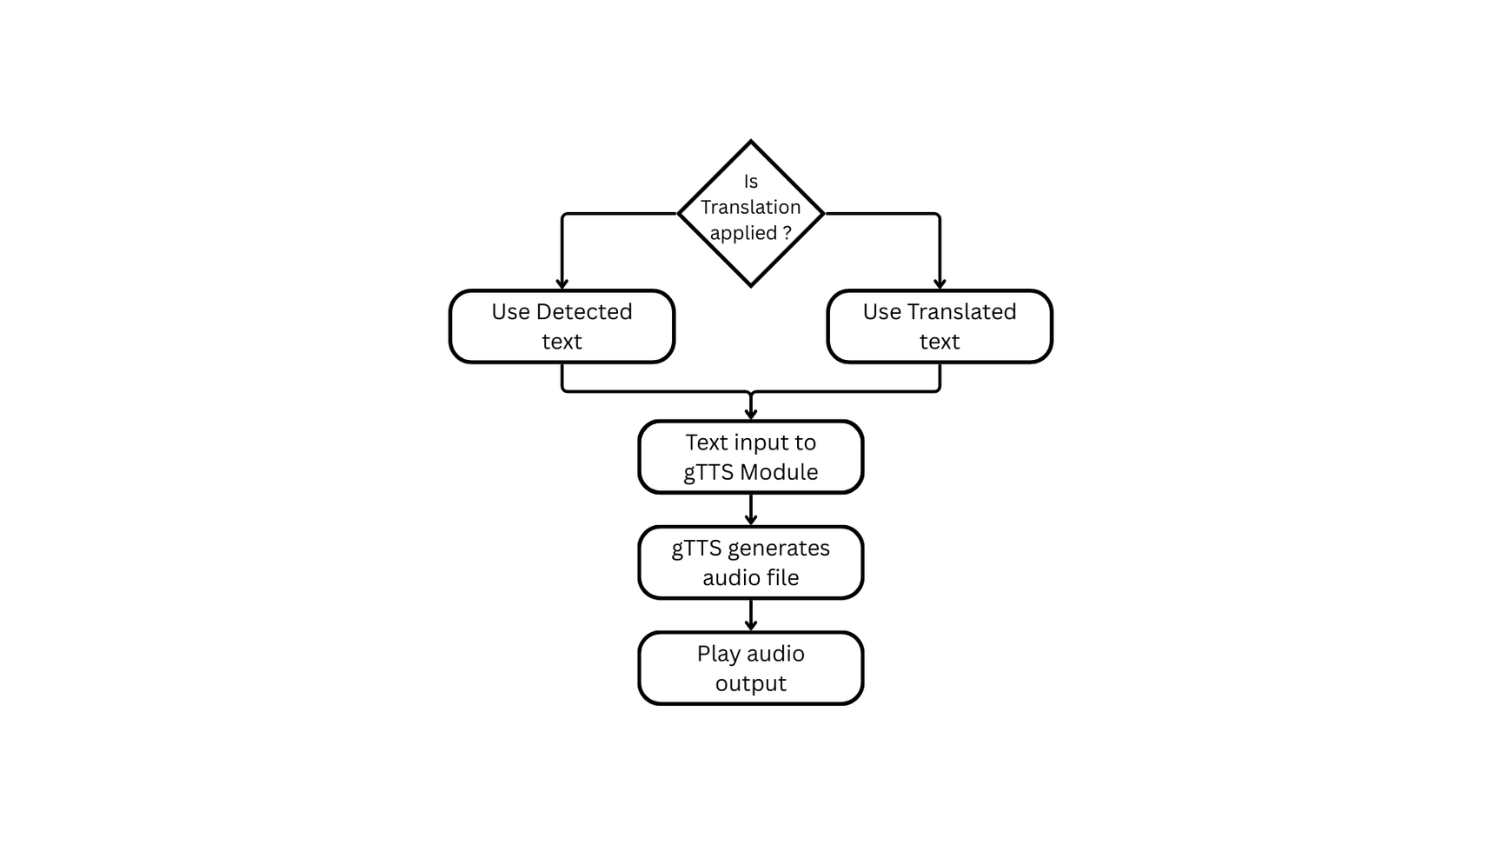
TEXT-TO-SPEECH SYNTHESIS MODULE
WORKING
18

Slide 19
POST-PROCESSING MODULE
Purpose - The purpose of the Post-Processing Module is to refine, evaluate, and format raw data or model outputs into actionable insights and user-friendly results.
Features
Error Detection and Correction: Identifies and fixes inaccuracies in results.
Result Formatting: Converts raw data into a structured, readable format.
Data Integration: Combines diverse outputs into a unified report.
Performance Metrics Generation: Provides evaluation metrics for model performance.
The Post-Processing Module is responsible for refining, formatting, and optimizing raw data or model outputs to ensure accuracy, clarity, and usability for analysis or decision-making.
19

Slide 20
ADVANTAGES
Enhanced Text Recognition Accuracy
Supports Multiple Language Translation
Improved Accessibility for Users
Faster Data Extraction Process
Seamless Integration with Applications
20

Slide 21
CONCLUSION
In conclusion, Text Detection and Extraction using Deep Learning Techniques with integrated features like Translation and Text-to-Speech offers a powerful solution for extracting and processing text from images or documents. This enhanced system improves accessibility, enables multilingual support, and provides seamless audio output, ensuring greater user convenience and engagement.
21

Slide 22
Thank you!

